Slide 1
We’re separate because...
We are Seventh Day Adventists!

Slide 2
Acts 11:26
“And in Antioch the disciples were first called Christians.”
Aren’t we ‘just’ Christians?

Slide 3
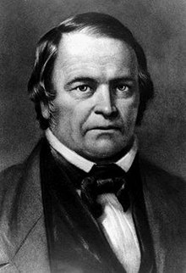
William Miller – 1844
Miller first arrived at this date in 1818
Published as document in 1822
Began to preach in 1831

Slide 4
What is the 2nd Coming?
Science increasingly suggests that ‘mankind’ is NOT going to survive on this earth
Pollution
Disease
‘Evolution’
The Bible states ‘sin’ as the insoluble problem
The resolution – Jesus return
That day will bring about the destruction of the heavens by fire, and the elements will melt in the heat. ¹³ But in keeping with his promise we are looking forward to a new heaven and a new earth, where righteousness dwells.
(2 Peter 3:12)

Slide 5
Old Testament References
Enoch
Enoch walked faithfully with God; then he was no more, because God took him away. (Genesis 5:24)
Elijah
As they were walking along and talking together, suddenly a chariot of fire and horses of fire appeared and separated the two of them, and Elijah went up to heaven in a whirlwind. (2 Kings 2:11)
Notes:
These references suggest the possibility of humans being ‘taken’ up to heaven

Slide 6
Jesus’ teaching?
Kingdom of heaven
²⁰ But store up for yourselves treasures in heaven, where moths and vermin do not destroy, and where thieves do not break in and steal. (Matthew 6:20)
“Let not your hearts be troubled. Believe in God;^{[a]} believe also in me. ² In my Father's house are many rooms. If it were not so, would I have told you that I go to prepare a place for you?^{[b]} ³ And if I go and prepare a place for you, I will come again and will take you to myself, that where I am you may be also. (John 14:1-3)

Slide 7
Jesus Goes . . .
⁹ And when he had said these things, as they were looking on, he was lifted up, and a cloud took him out of their sight. ¹⁰ And while they were gazing into heaven as he went, behold, two men stood by them in white robes, ¹¹ and said, “Men of Galilee, why do you stand looking into heaven? This Jesus, who was taken up from you into heaven, will come in the same way as you saw him go into heaven.” (Acts 1:9-11)

Slide 8
1 Thessalonians
³ But we do not want you to be uninformed, brothers, about those who are asleep, that you may not grieve as others do who have no hope.
¹⁶ For the Lord himself will descend from heaven with a cry of command, with the voice of an archangel, and with the sound of the trumpet of God. And the dead in Christ will rise first. ¹⁷ Then we who are alive, who are left, will be caught up together with them in the clouds to meet the Lord in the air, and so we will always be with the Lord. ¹⁸ Therefore encourage one another with these words. (1 Thessalonians 4:3-18)

Slide 9
Revelation – Final events. . .
“Fear God and give him glory, because the hour of his judgment has come, and worship him who made heaven and earth, the sea and the springs of water.” (Revelation 14:7)
“Here is a call for the endurance of the saints, those who keep the commandments of God and their faith in Jesus.” (Revelation 14:12)
“Then I looked, and behold, a white cloud, and seated on the cloud one like a son of man, with a golden crown on his head, and a sharp sickle in his hand.” (Revelation 14:14)

Slide 10
Revelation – Judgement. . .
¹¹ Then I saw a great white throne and him who was seated on it. From his presence earth and sky fled away, and no place was found for them. ¹² And I saw the dead, great and small, standing before the throne, and books were opened. Then another book was opened, which is the book of life. And the dead were judged by what was written in the books, according to what they had done.
(Revelation 20)

Slide 11
Revelation – Renewal. . .
Then I saw a new heaven and a new earth, for the first heaven and the first earth had passed away, and the sea was no more.
“Behold, the dwelling place^{[a]} of God is with man. He will dwell with them, and they will be his people,^{[b]} and God himself will be with them as their God.^{[c]} ⁴ He will wipe away every tear from their eyes, and death shall be no more, neither shall there be mourning, nor crying, nor pain anymore, for the former things have passed away.”
⁵ And he who was seated on the throne said, “Behold, I am making all things new.”
(Revelation 21)

Slide 12
Revelation – Restoration. . .
Then the angel showed me the river of the water of life, as clear as crystal, flowing from the throne of God and of the Lamb ² down the middle of the great street of the city. On each side of the river stood the tree of life, bearing twelve crops of fruit, yielding its fruit every month. And the leaves of the tree are for the healing of the nations. ³ No longer will there be any curse.
Revelation 22

Slide 13
William Miller - Biography
Originally a Baptist
At various times:
Sherif
Leutenant
Recruiter
Captain
Fought in the Battle of Platsburgh (war of 1812)
Moved to Poultney – became a Deist
Experience in battle !
After war – became a more ardent Bible student

Slide 14
William Miller – Hermeneutics
Allegorical
Proof Texts
“And Benaiah the son of Jehoiada was a valiant man^{[a]} of Kabzeel, a doer of great deeds. He struck down two heroes of Moab. He also went down and struck down a lion in a pit on a day when snow had fallen.” (I Chronicles 11:22)

Slide 15
Miller’s 15 ‘Proofs’
Proof II. It is proved typically by the year of release. See Deut. xv. 1, 2: "At the end of every seventh years thou shalt make a release; and this is the manner of the release; every creditor that lendeth aught unto his neighbour shall release it; he shall not exact of his neighbour or of his brother, because it is called the Lords release." Also Jer. xxiv. 14: "At the end of seven years let ye go every man his brother a Hebrew, which hath been sold unto thee, and "when he hath served thee six years, thou shalt let him go free from thee; but your fathers hearkened not unto me, neither inclined their ear." We are, by this type, taught that the People of God will be delivered from their servitude and bondage, when they have served their 7 prophetic years. 7 times 360 years is 2520. Beginning with the captivity of Israel and the king of Judah, Manasseh, 677 B. C., must end in A. D. 1843, when the children of God will be released from all bondage and slavery.

Slide 16
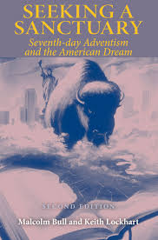
Millennial mindset. . .
We are living, we are dwelling, In a grand and awful time, In an age on ages telling; To be living is sublime. Hark! the waking up of nations, Hosts advancing to the fray; Hark! what soundeth is creation’s Groaning for the latter day.
A Cleveland Coxe - 1838
Notes:
Scorpions wind of change 1990

Slide 17
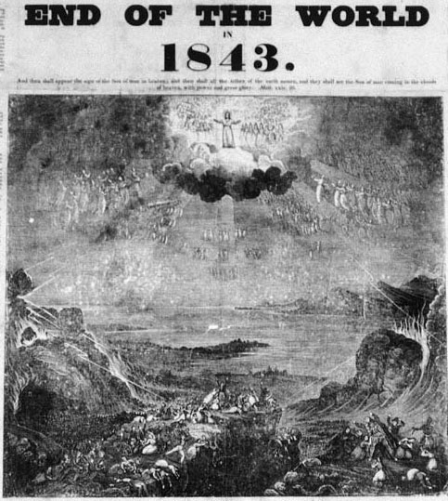
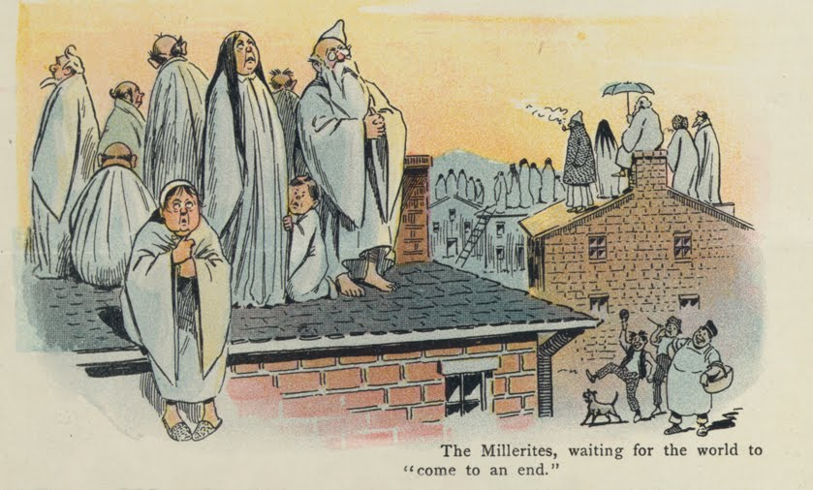
The Great Disappointment

Slide 18
Millerites – Post Disappointment
Most - Humbly returned to churches
Many - Lost their faith entirely
A small minority - Refused to give up on their belief in Christ’s soon return (Perhaps fewer than 100 persons - G R Knight, Andrews University)

Slide 19
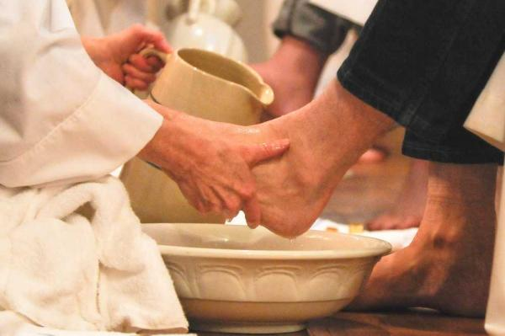
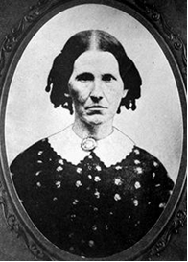
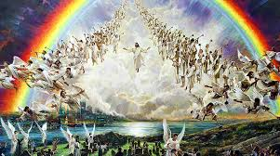
Scriptural Consequences

Slide 20
Key Doctrine – 7th Day Sabbath
Seventh Day Baptist
1845 – 6000 members in US
(Today - 5,000)
50,000 members worldwide
Seventh Day Adventist
1845 - <100 members
15 million members

Slide 21
Significance of ‘Adventists’ - 1
Unique understanding of 2nd Advent / end-time events
State of the dead
Literal return of Christ
Judgement
Millennial hopes – in heaven

Slide 22
Significance of ‘Adventists’ - 2
Unique depiction of end-time Christian church
Seal of God vs False worship
Commandments play a part in allegiance
Avoidance of ‘Laodicean’ condition
(Revelation 3:16:17)

Slide 23
2 Peter 3:1-13
This is now the second letter that I am writing to you, beloved. In both of them I am stirring up your sincere mind by way of reminder, ² that you should remember the predictions of the holy prophets and the commandment of the Lord and Saviour through your apostles, ³ knowing this first of all, that scoffers will come in the last days with scoffing, following their own sinful desires. ⁴ They will say, “Where is the promise of his coming? For ever since the fathers fell asleep, all things are continuing as they were from the beginning of creation.”

Slide 24
2 Peter 3:1-13
⁵ For they deliberately overlook this fact, that the heavens existed long ago, and the earth was formed out of water and through water by the word of God, ⁶ and that by means of these the world that then existed was deluged with water and perished. ⁷ But by the same word the heavens and earth that now exist are stored up for fire, being kept until the day of judgment and destruction of the ungodly.

Slide 25
2 Peter 3:1-13
⁸ But do not overlook this one fact, beloved, that with the Lord one day is as a thousand years, and a thousand years as one day. ⁹ The Lord is not slow to fulfil his promise as some count slowness, but is patient toward you,^{[a]} not wishing that any should perish, but that all should reach repentance. ¹⁰ But the day of the Lord will come like a thief, and then the heavens will pass away with a roar, and the heavenly bodies^{[b]} will be burned up and dissolved, and the earth and the works that are done on it will be exposed.^{[c]}

Slide 26
2 Peter 3:1-13
¹¹ Since all these things are thus to be dissolved, what sort of people ought you to be in lives of holiness and godliness, ¹² waiting for and hastening the coming of the day of God, because of which the heavens will be set on fire and dissolved, and the heavenly bodies will melt as they burn! ¹³ But according to his promise we are waiting for new heavens and a new earth in which righteousness dwells.

Slide 27
2 Peter 3:1-13
¹¹ Since all these things are thus to be dissolved, what sort of people ought you to be in lives of holiness and godliness, ¹² waiting for and hastening the coming of the day of God, because of which the heavens will be set on fire and dissolved, and the heavenly bodies will melt as they burn! ¹³ But according to his promise we are waiting for new heavens and a new earth in which righteousness dwells.

Slide 28
Conclusions 1
SDAs have 2 key doctrines which set us apart
The 7th day Sabbath is significant (reference to creation)
The 2nd Advent is of primary significance
Our understanding of that message makes us unique – or not

